Slide 1
Architecture of Enterprise Applications 9 Web Services
Haopeng Chen
REliable, INtelligent and Scalable Systems Group (REINS)
Shanghai Jiao Tong University
Shanghai, China
http://reins.se.sjtu.edu.cn/~chenhp
e-mail: chen-hp@sjtu.edu.cn

Slide 2
Contents and Objectives
Contents
WS Overview
SOAP WS
RESTful WS
Objectives
能够根据业务需求，识别需要封装为Web服务的业务功能，并能够将其实现为Restful Web服务

Slide 3
Web Services Overview
Web Services
present the opportunity for real interoperability across hardware, operating systems, programming languages, and applications.
Web
Access with web protocols
Services
Independent of the implementation

Slide 4
SOAP
SOAP is defined by its own XML Schema and relies heavily on the use of XML Namespaces.
Here's a SOAP request message that might be sent from a client to a server:
<?xml version='1.0' encoding='UTF-8' ?>
<env:Envelope
xmlns:env="http://schemas.xmlsoap.org/soap/envelope/">
<env:Header />
<env:Body>
<reservation xmlns="http://www.titan.com/Reservation">
<customer>
<!-- customer info goes here -->
</customer>
</reservation>
</env:Body>
</env:Envelope>

Slide 5
WSDL
Imagine that you want to develop a web services component that implements the following interface:
public interface TravelAgent {
public String makeReservation(int cruiseID,
int cabinID, int customerId, double price);
}

Slide 6
WSDL
A WSDL document that describes the makeReservation( ) method might look like this:
<?xml version="1.0"?>
<definitions name="TravelAgent"
xmlns="http://schemas.xmlsoap.org/wsdl/"
xmlns:soap="http://schemas.xmlsoap.org/wsdl/soap/"
xmlns:xsd="http://www.w3.org/2001/XMLSchema"
xmlns:titan="http://www.titan.com/TravelAgent"
targetNamespace="http://www.titan.com/TravelAgent">
<!-- message elements describe the parameters and return values -->
<message name="RequestMessage">
<part name="cruiseId" type="xsd:int" />
<part name="cabinId" type="xsd:int" />
<part name="customerId" type="xsd:int" />
<part name="price" type="xsd:double" />
</message>
<message name="ResponseMessage">
<part name="reservationId" type="xsd:string" />
</message>

Slide 7
WSDL
<!-- portType element describes the abstract interface of a web service -->
<portType name="TravelAgent">
<operation name="makeReservation">
<input message="titan:RequestMessage"/>
<output message="titan:ResponseMessage"/>
</operation>
</portType>
<!--binding element tells us which protocols and encoding styles are used -->
<binding name="TravelAgentBinding" type="titan:TravelAgent">
<soap:binding style="rpc“ transport="http://schemas.xmlsoap.org/soap/http"/>
<operation name="makeReservation">
<soap:operation soapAction="" />
<input>
<soap:body use="literal" namespace="http://www.titan.com/TravelAgent"/>
</input>
<output>
<soap:body use="literal" namespace="http://www.titan.com/TravelAgent"/>
</output>
</operation>
</binding>

Slide 8
WSDL
<!-- service element tells us the Internet address of a web service -->
<service name="TravelAgentService">
<port name="TravelAgentPort" binding="titan:TravelAgentBinding">
<soap:address location="http://www.titan.com/webservices/TravelAgent" />
</port>
</service>
</definitions>

Slide 9
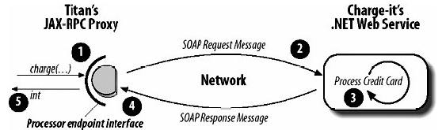
Accessing Web Service

Slide 10
Producing a SOAP Web Service
pom.xml
<dependencies> <dependency> <groupId>org.springframework.boot</groupId> <artifactId>spring-boot-starter-web</artifactId> </dependency> <dependency> <groupId>org.springframework.boot</groupId> <artifactId>spring-boot-starter-web-services</artifactId> </dependency> <!-- tag::springws[] --> <dependency> <groupId>wsdl4j</groupId> <artifactId>wsdl4j</artifactId> </dependency> <!-- end::springws[] --> </dependencies>

Slide 11
Producing a SOAP Web Service
<!-- tag::xsd[] --> <plugin> <groupId>org.codehaus.mojo</groupId> <artifactId>jaxb2-maven-plugin</artifactId> <version>2.5.0</version> <executions> <execution> <id>xjc</id> <goals> <goal>xjc</goal> </goals> </execution> </executions> <configuration> <sources> <source>${project.basedir}/src/main/resources/countries.xsd</source> </sources> </configuration> </plugin> <!-- end::xsd[] -->
pom.xml

Slide 12
Producing a SOAP Web Service
countries.xsd
<xs:element name="getCountryRequest"> <xs:complexType> <xs:sequence> <xs:element name="name" type="xs:string"/> </xs:sequence> </xs:complexType> </xs:element> <xs:element name="getCountryResponse"> <xs:complexType> <xs:sequence> <xs:element name="country" type="tns:country"/> </xs:sequence> </xs:complexType> </xs:element>

Slide 13
Producing a SOAP Web Service
countries.xsd
<xs:complexType name="country"> <xs:sequence> <xs:element name="name" type="xs:string"/> <xs:element name="population" type="xs:int"/> <xs:element name="capital" type="xs:string"/> <xs:element name="currency" type="tns:currency"/> </xs:sequence> </xs:complexType> <xs:simpleType name="currency"> <xs:restriction base="xs:string"> <xs:enumeration value="GBP"/> <xs:enumeration value="EUR"/> <xs:enumeration value="PLN"/> </xs:restriction> </xs:simpleType> </xs:schema>

Slide 14
Producing a SOAP Web Service
CountryRepository.java
import io.spring.guides.gs_producing_web_service.Country; import io.spring.guides.gs_producing_web_service.Currency; @Component public class CountryRepository { private static final Map<String, Country> countries = new HashMap<>(); @PostConstruct public void initData() { Country spain = new Country(); spain.setName("Spain"); spain.setCapital("Madrid"); spain.setCurrency(Currency.EUR); spain.setPopulation(46704314); countries.put(spain.getName(), spain);

Slide 15
Producing a SOAP Web Service
Country poland = new Country(); poland.setName("Poland"); poland.setCapital("Warsaw"); poland.setCurrency(Currency.PLN); poland.setPopulation(38186860); countries.put(poland.getName(), poland); Country uk = new Country(); uk.setName("United Kingdom"); uk.setCapital("London"); uk.setCurrency(Currency.GBP); uk.setPopulation(63705000); countries.put(uk.getName(), uk); } public Country findCountry(String name) { Assert.notNull(name, "The country's name must not be null"); return countries.get(name); } }
CountryRepository.java

Slide 16
Producing a SOAP Web Service
import io.spring.guides.gs_producing_web_service.GetCountryRequest; import io.spring.guides.gs_producing_web_service.GetCountryResponse; @Endpoint public class CountryEndpoint { private static final String NAMESPACE_URI = "http://spring.io/guides/gs-producing-web-service"; private CountryRepository countryRepository; @Autowired public CountryEndpoint(CountryRepository countryRepository) { this.countryRepository = countryRepository; } @PayloadRoot(namespace = NAMESPACE_URI, localPart = "getCountryRequest") @ResponsePayload public GetCountryResponse getCountry(@RequestPayload GetCountryRequest request) { GetCountryResponse response = new GetCountryResponse(); response.setCountry(countryRepository.findCountry(request.getName())); return response; } }
CountryEndpoint.java

Slide 17
Producing a SOAP Web Service
WebServiceConfig.java
@EnableWs @Configuration public class WebServiceConfig extends WsConfigurerAdapter { @Bean public ServletRegistrationBean messageDispatcherServlet(ApplicationContext applicationContext) { MessageDispatcherServlet servlet = new MessageDispatcherServlet(); servlet.setApplicationContext(applicationContext); servlet.setTransformWsdlLocations(true); return new ServletRegistrationBean(servlet, "/ws/*"); } @Bean(name = "countries") public DefaultWsdl11Definition defaultWsdl11Definition(XsdSchema countriesSchema) { DefaultWsdl11Definition wsdl11Definition = new DefaultWsdl11Definition(); wsdl11Definition.setPortTypeName("CountriesPort"); wsdl11Definition.setLocationUri("/ws"); wsdl11Definition.setTargetNamespace("http://spring.io/guides/gs-producing-web-service"); wsdl11Definition.setSchema(countriesSchema); return wsdl11Definition; } @Bean public XsdSchema countriesSchema() { return new SimpleXsdSchema(new ClassPathResource("countries.xsd")); } }

Slide 18
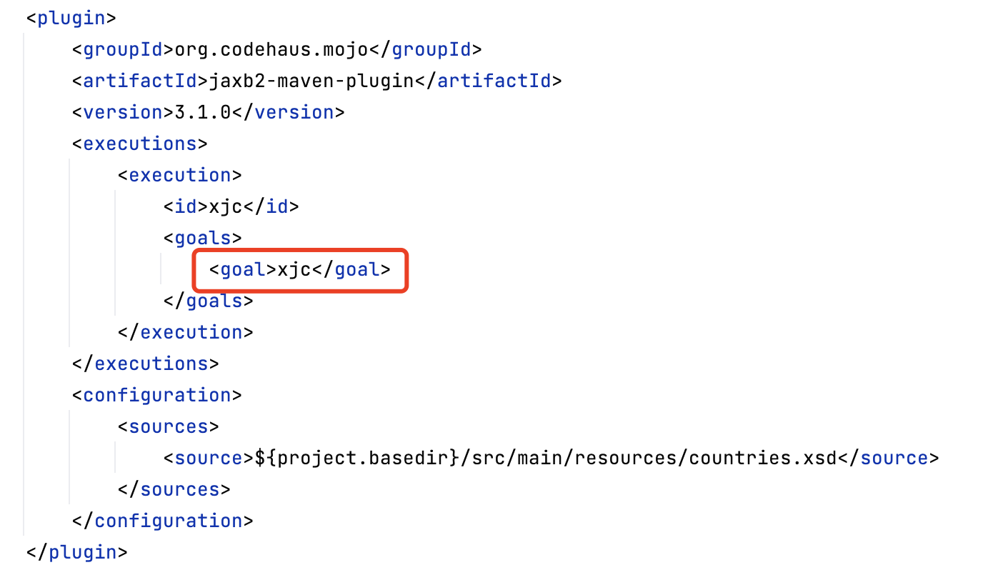
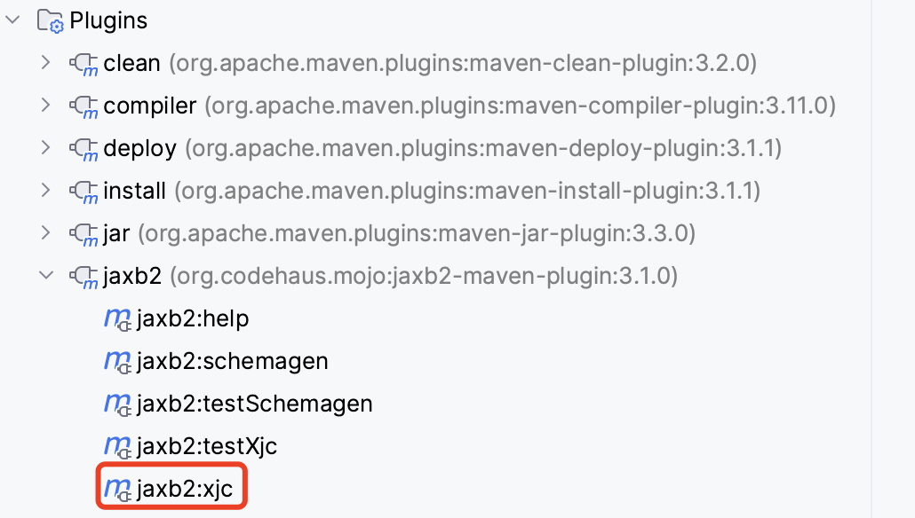
Producing a SOAP Web Service
Generate Domain Classes Based on an XML Schema

Slide 19
Producing a SOAP Web Service
request.xml
<soapenv:Envelope xmlns:soapenv="http://schemas.xmlsoap.org/soap/envelope/" xmlns:gs="http://spring.io/guides/gs-producing-web-service"> <soapenv:Header/> <soapenv:Body> <gs:getCountryRequest> <gs:name>Spain</gs:name> </gs:getCountryRequest> </soapenv:Body> </soapenv:Envelope>

Slide 20
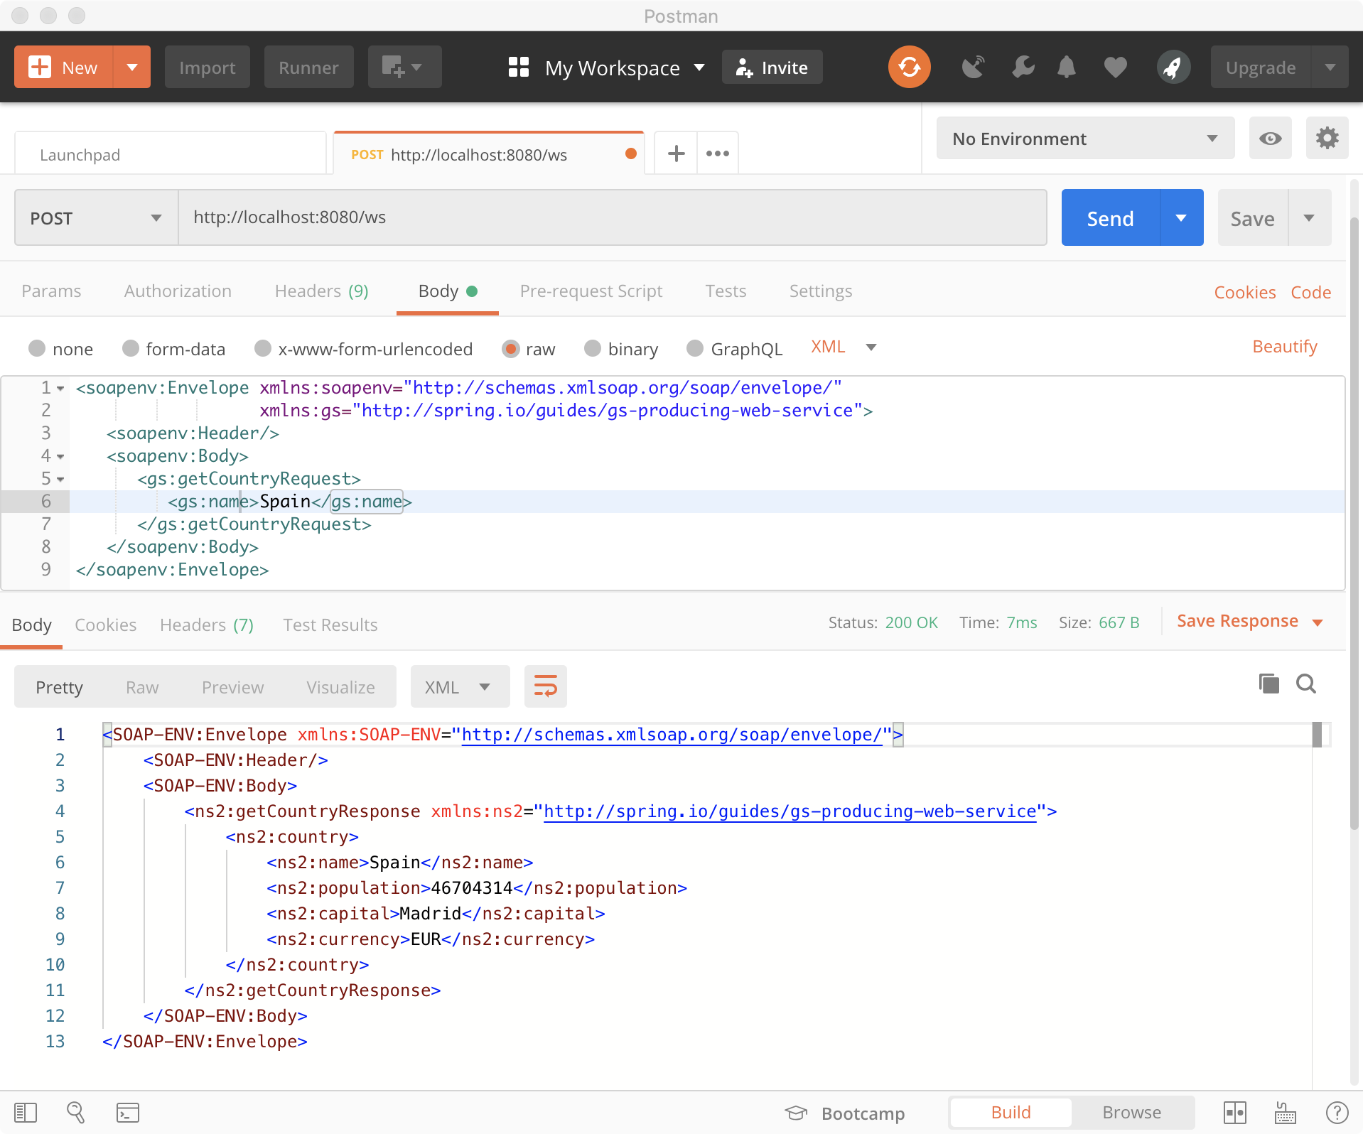
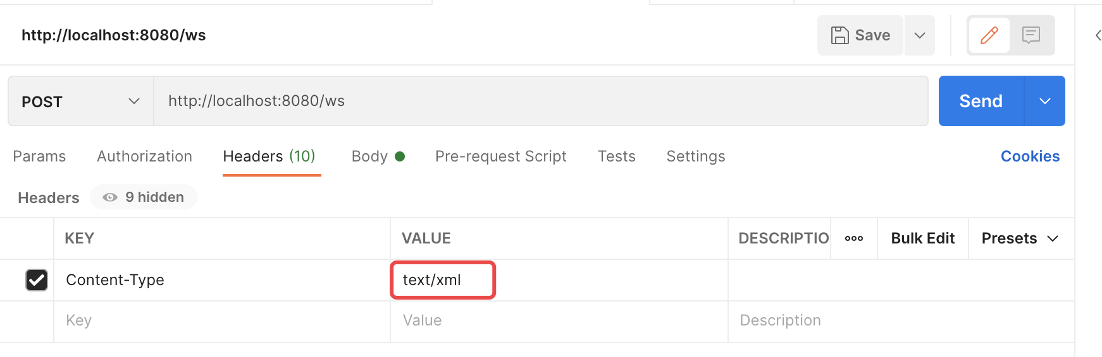
Producing a SOAP Web Service
Test the Web Service with Postman

Slide 21
Consuming a SOAP web service
pom.xml
<!-- tag::dependency[] --> <dependency> <groupId>org.springframework.boot</groupId> <artifactId>spring-boot-starter-web-services</artifactId> <exclusions> <exclusion> <groupId>org.springframework.boot</groupId> <artifactId>spring-boot-starter-tomcat</artifactId> </exclusion> </exclusions> </dependency> <!-- end::dependency[] -->

Slide 22
Consuming a SOAP web service
pom.xml
<!-- tag::wsdl[] --> <plugin> <groupId>com.sun.xml.ws</groupId> <artifactId>jaxws-maven-plugin</artifactId> <version>3.0.0</version> <executions> <execution> <goals> <goal>wsimport</goal> </goals> </execution> </executions> <configuration> <packageName>org.reins.se3353.se3353_9_soapwsconsumer.wsdl</packageName> <wsdlUrls> <wsdlUrl>http://localhost:8080/ws/countries.wsdl</wsdlUrl> </wsdlUrls> <sourceDestDir>${sourcesDir}</sourceDestDir> <destDir>${classesDir}</destDir> <extension>true</extension> </configuration> </plugin> <!-- end::wsdl[] -->

Slide 23
Consuming a SOAP web service
CountryClient.class
public class CountryClient extends WebServiceGatewaySupport { private static final Logger log = LoggerFactory.getLogger(CountryClient.class); public GetCountryResponse getCountry(String country) { GetCountryRequest request = new GetCountryRequest(); request.setName(country); log.info("Requesting location for " + country); GetCountryResponse response = (GetCountryResponse) getWebServiceTemplate() .marshalSendAndReceive("http://localhost:8080/ws/countries", request, new SoapActionCallback( "http://spring.io/guides/gs-producing-web-service/GetCountryRequest")); return response; } }

Slide 24
Consuming a SOAP web service
CountryConfiguration.class
@Configuration public class CountryConfiguration { @Bean public Jaxb2Marshaller marshaller() { Jaxb2Marshaller marshaller = new Jaxb2Marshaller(); // this package must match the package in the <generatePackage> specified in // pom.xml marshaller.setContextPath("org.reins.se3353.se3353_9_soapwsconsumer.wsdl"); return marshaller; } @Bean public CountryClient countryClient(Jaxb2Marshaller marshaller) { CountryClient client = new CountryClient(); client.setDefaultUri("http://localhost:8080/ws"); client.setMarshaller(marshaller); client.setUnmarshaller(marshaller); return client; } }

Slide 25
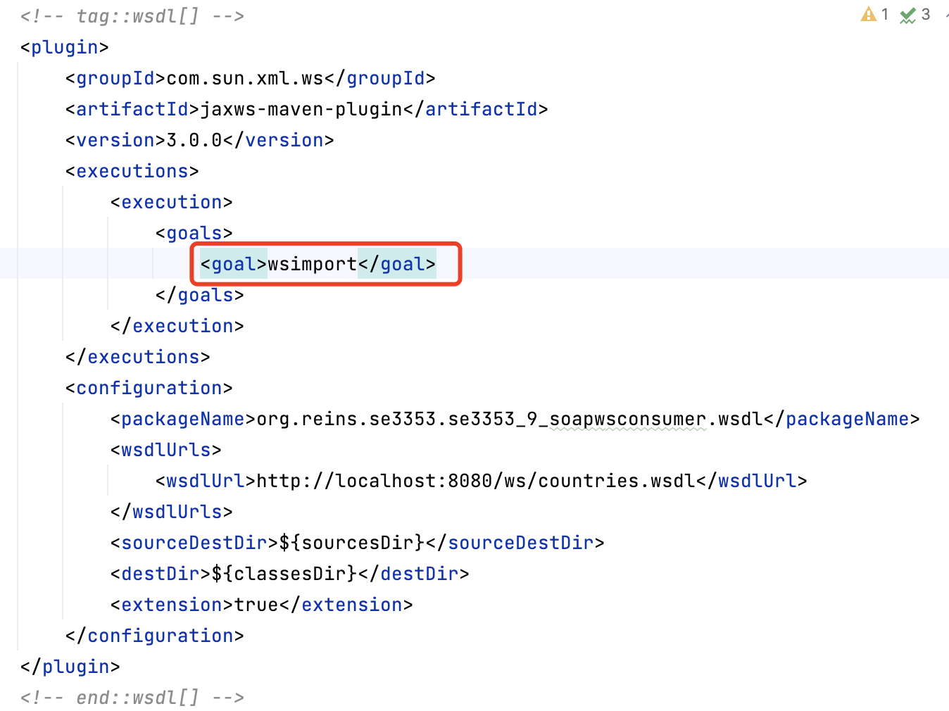
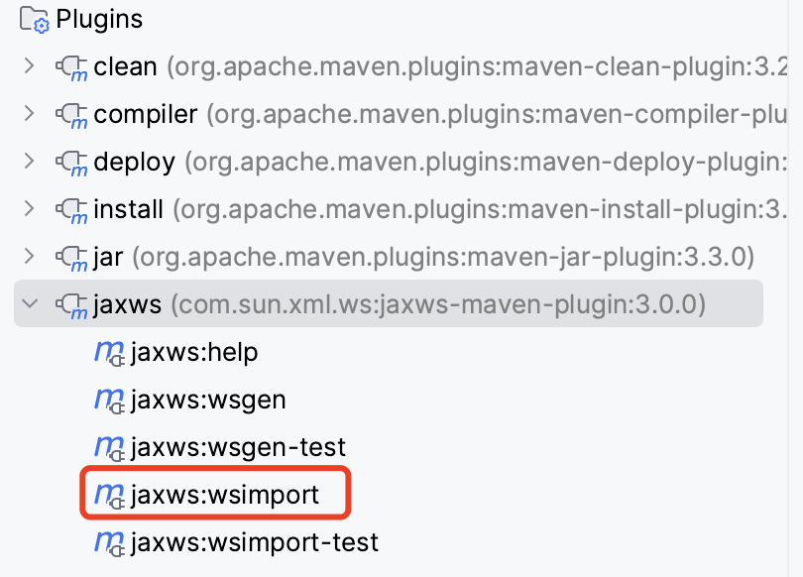
Consuming a SOAP web service
Generate Domain Objects Based on a WSDL

Slide 26
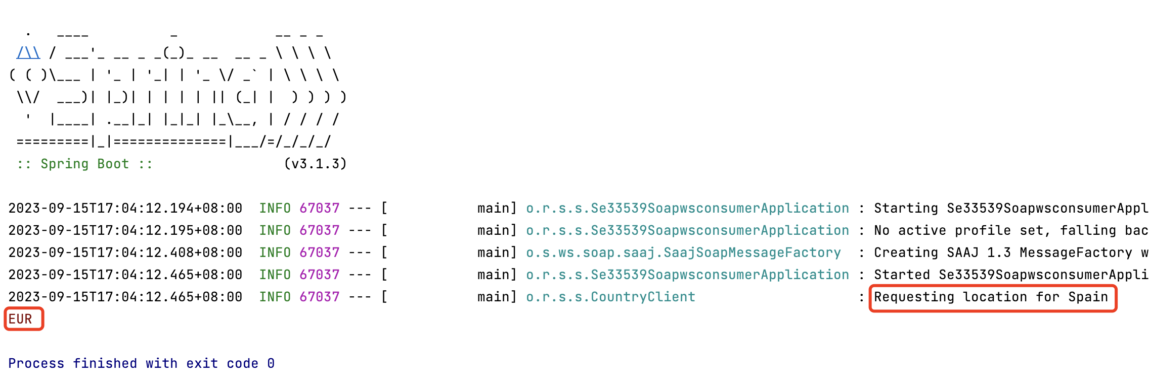
Consuming a SOAP web service

Slide 28
JAX-WS Web Service
@WebService public class Warehouse { public Warehouse() { prices = new HashMap<String, Double>(); prices.put("Blackwell Toaster", 24.95); prices.put("ZapXpress Microwave Oven", 49.95); } public double getPrice(@WebParam(name=”parameters") String description) { Double price = prices.get(description.trim()); return price == null ? 0 : price; } private Map<String, Double> prices; public static void main(String[] argv) { Object implementor = new Warehouse (); String address = "http://localhost:9000/Warehouse"; Endpoint.publish(address, implementor); } }
Warehouse.java
Notes:
先运行Tomcat，然后运行main函数

Slide 29
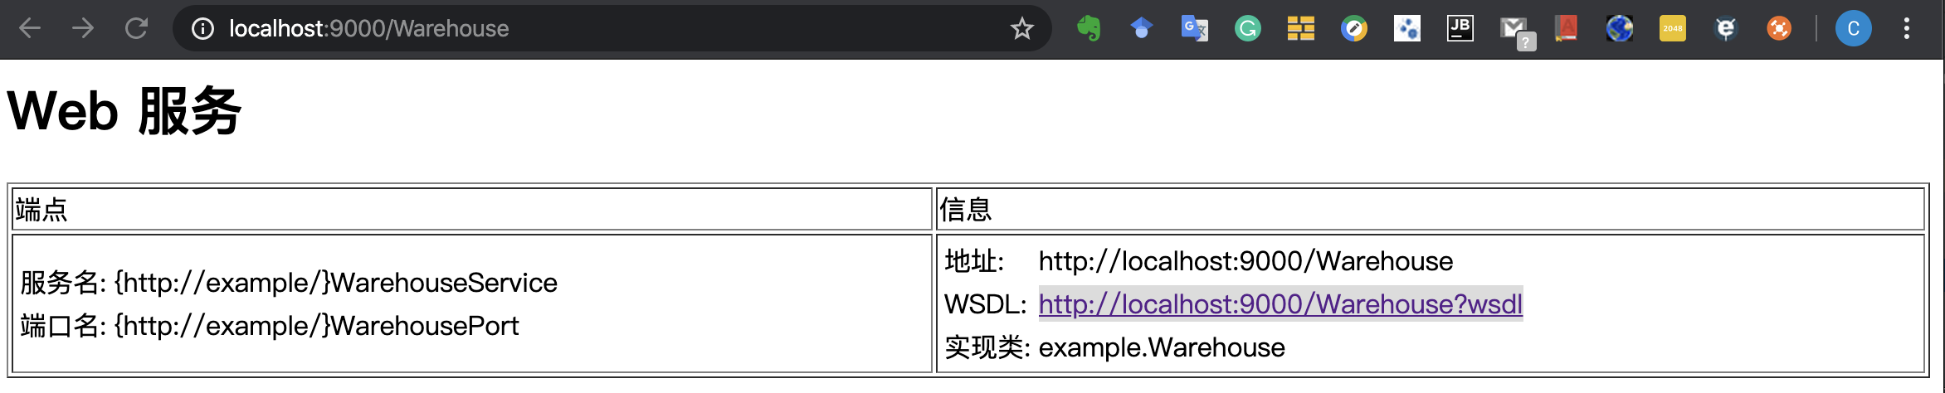
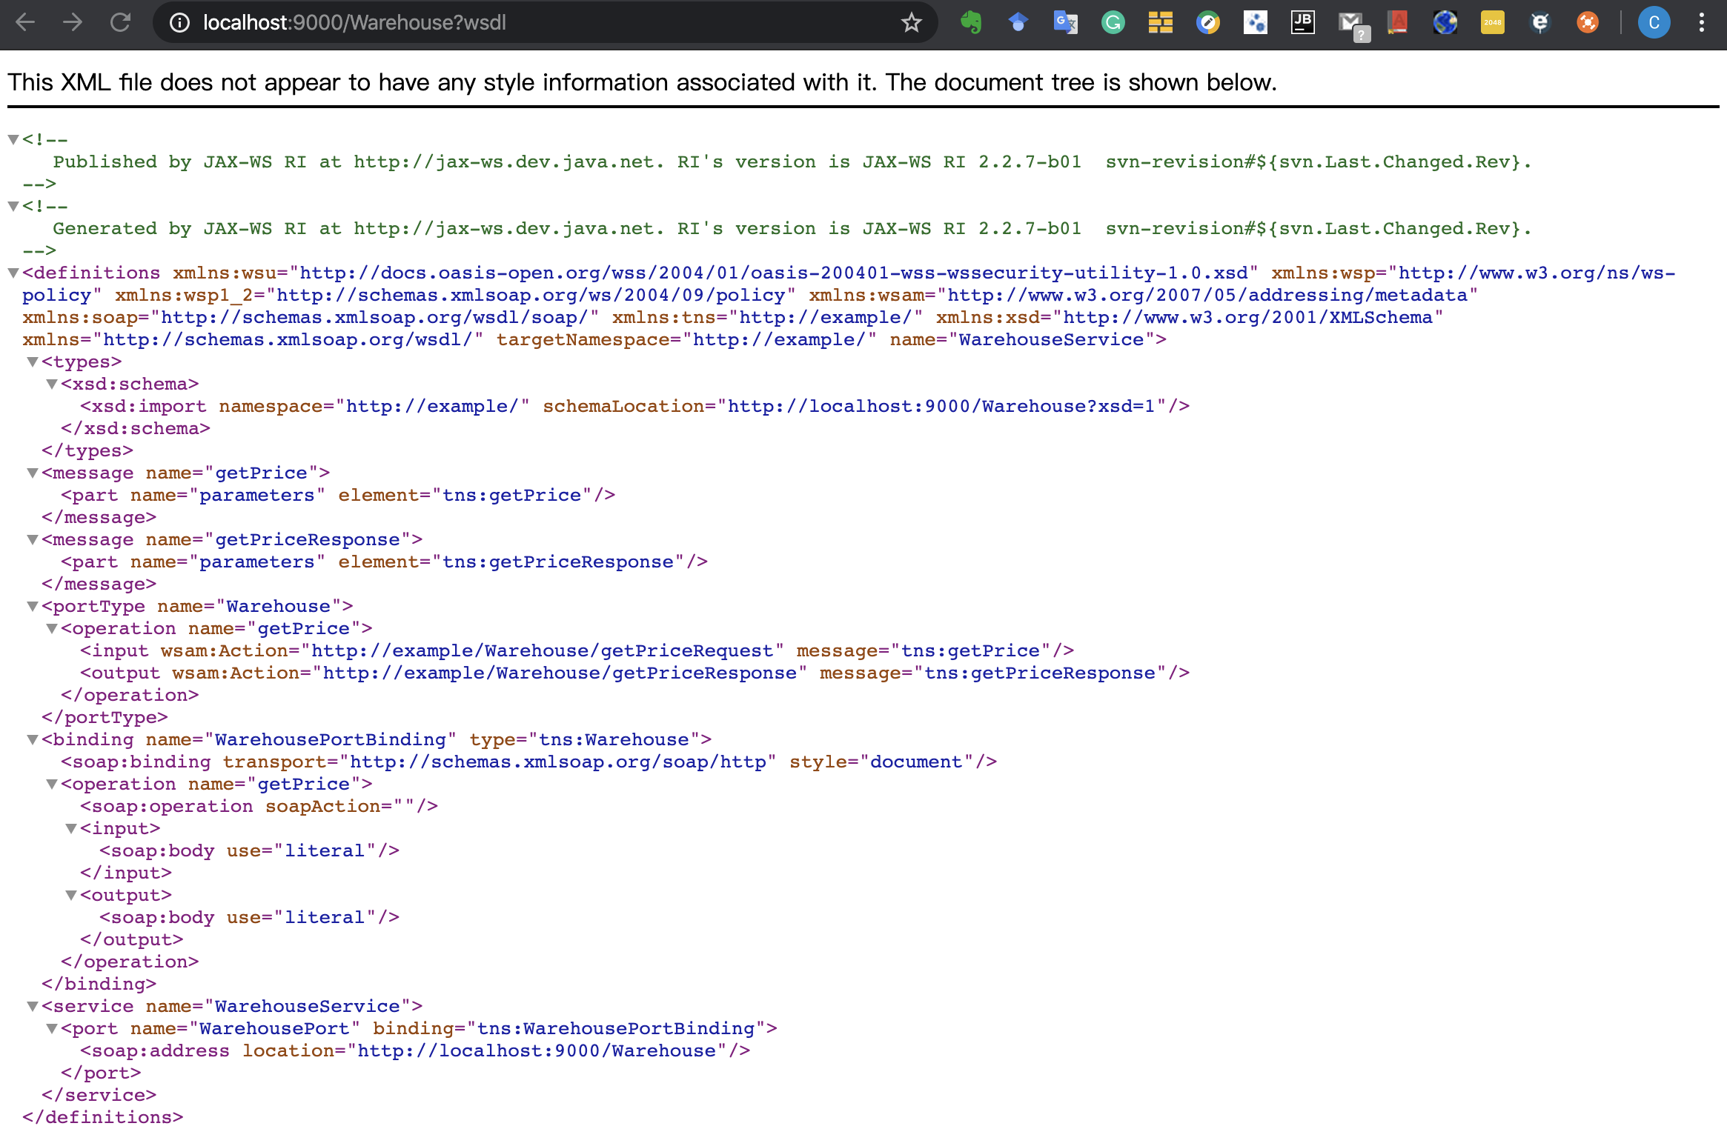
JAX-WS Web Service
http://localhost:9000/Warehouse?wsdl

Slide 30
JAX-WS Web Service
<soapenv:Envelope xmlns:soapenv="http://schemas.xmlsoap.org/soap/envelope/"
xmlns:gs="http://example/">
<soapenv:Header/>
<soapenv:Body>
<gs:getPrice>
<parameters>Blackwell Toaster</parameters>
</gs:getPrice>
</soapenv:Body>
</soapenv:Envelope>

Slide 31
JAX-WS Web Service
<?xml version='1.0' encoding='UTF-8'?>
<S:Envelope xmlns:S="http://schemas.xmlsoap.org/soap/envelope/">
<S:Body>
<ns2:getPriceResponse xmlns:ns2="http://example/">
<return>24.95</return>
</ns2:getPriceResponse>
</S:Body>
</S:Envelope>

Slide 32
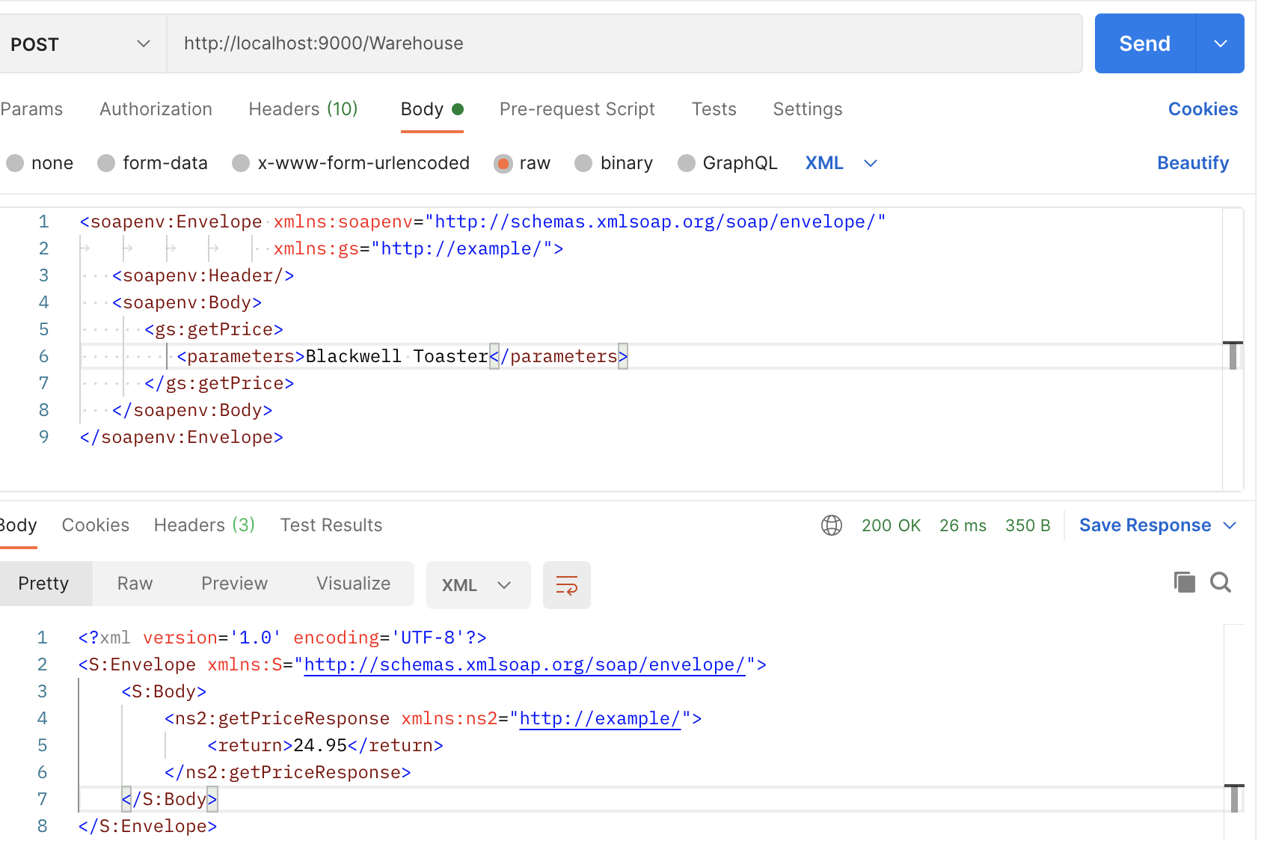
JAX-WS Web Service

Slide 33
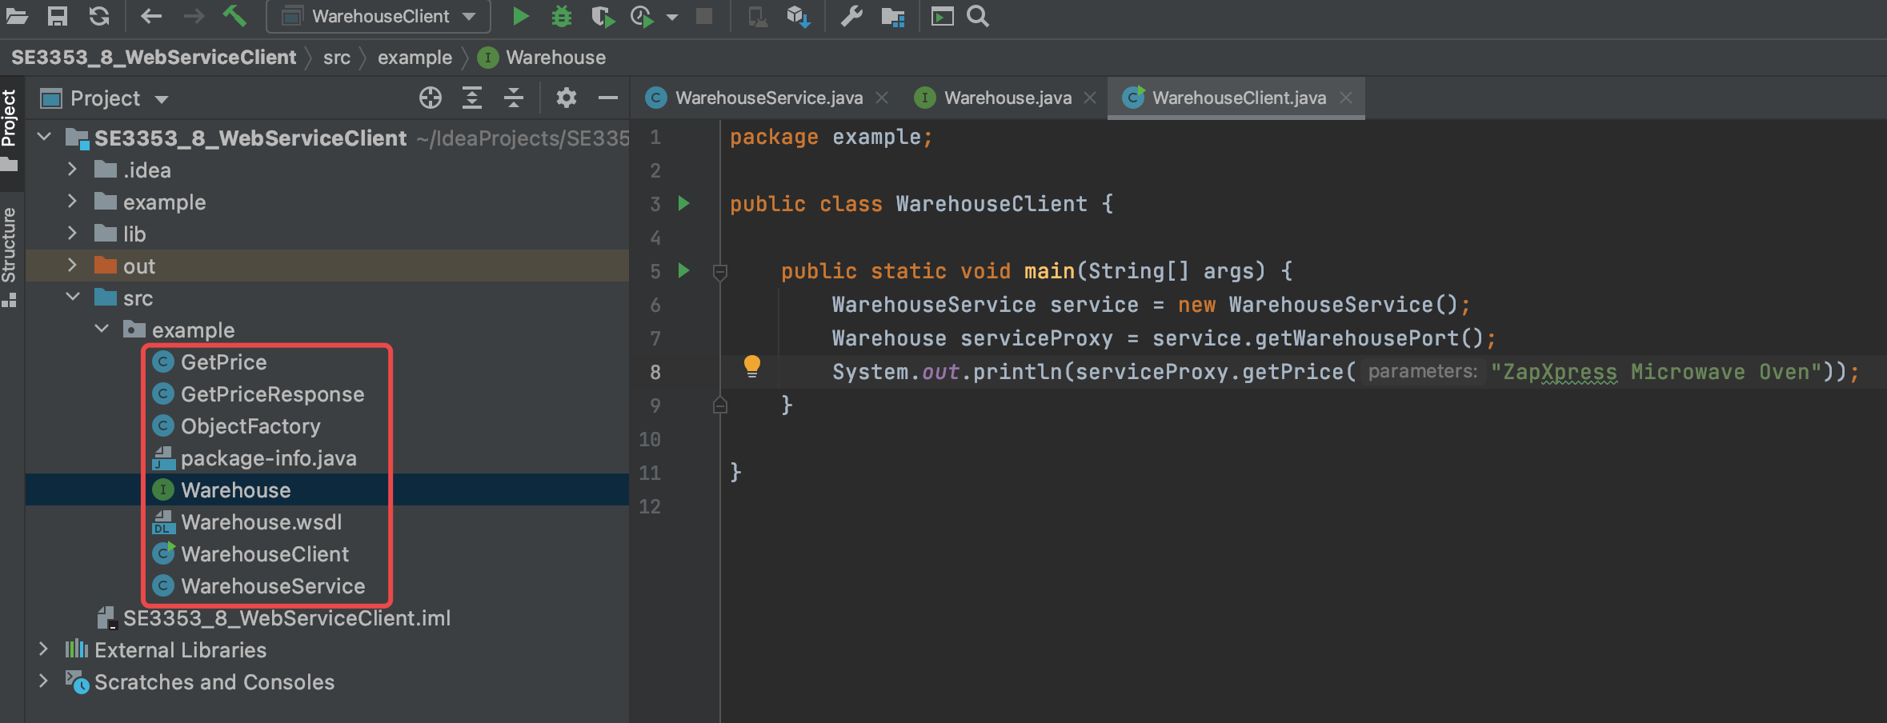
Consuming JAX-WS in Java
Generate classes with wsimport
wsimport -s <generate your source file location> http://localhost:9000/Warehouse?wsdl

Slide 34
Consuming JAX-WS in Java
WarehouseClient.java
package example; public class WarehouseClient { public static void main(String[] args) { WarehouseService service = new WarehouseService(); Warehouse serviceProxy = service.getWarehousePort(); System.out.println(serviceProxy.getPrice("ZapXpress Microwave Oven")); } }

Slide 36
Why
SOAP-based Web Services
Coupling with the message format
Coupling with the encoding of WS
Parse and assemble SOAP
Need a WSDL to describe the details of WS
Need a proxy generated from WSDL
It is a time-cost way to implement Web Service with SOAP
We should find a new way to implement WS

Slide 37
Restful Web Service
REpresentational State Transfer
Representational:
All data are resources. Representation for client.
Each resource can have different representations
Each resource has its own unique identity(URI)
State:
It refers to state of client. Server is stateless.
The representation of resource is a state of client.
Transfer:
Client’s representation will be transferred when client access different resources by different URI.
It means the states of client are also transferred.
That is Representation State Transfer

Slide 38
What
REST is a kind of architecture, but not a specification
REST is a typical Client-Server architecture, but it is stateless server
All states are hold in the messages delivered between clients and server
Server only process the requirements of data, displaying is completely depended on clients
REST is idempotent which means server will return same results for same require. So the results can be cached on either clients or server

Slide 39
What
In REST, all operations are preformed in unified way
Each resource has a unique identity
Process resource by representation
Client can not directly manipulate resources.
Client only can manipulate its representation, and send requires.
Server process requires and return response.
Any message between clients and server is self-described.
The context for processing a message is contained in the message itself.
Multimedia interaction system.
The content delivered between clients and server can be documents, pictures, audios, and videos
It is the base for resource to be rendered as different representations.

Slide 40
How to design REST
Design rules
Anything on web is abstracted as resource
Any resource has a unique resource identifier
Access resource by generic connector interface
Any manipulation to resource doesn’t change resource identifier
All operations are stateless
Resources are not data, but the combination of data and representation
Same data with different representation will be abstracted as different resources.

Slide 41
How to design REST
CRUD
Atomic operations: Create, Read, Update, Delete
Composite them to build complex manipulate
HTTP-based
GET-read
POST-create
PUT-update
DELETE-delete
Design by URL
We just need to design suitable URLs which directly represent user interface
Developers just need to abstract resources according to URLs
URL without parameters is more convenient for user
Quite different from action-based design method, such as MVC
Notice: it is very difficult to abstract anything on web as resource
Mix MVC and REST

Slide 42
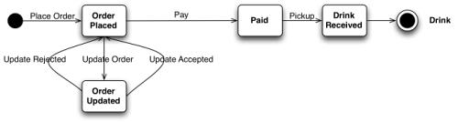

How to Get a Cup of Coffee

Slide 43
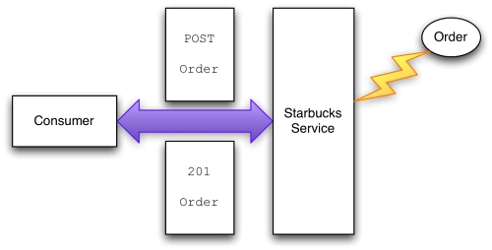
How to Get a Cup of Coffee
Request:
POST /order HTTP1.1
Host: starbucks.example.org
Content-Type: application/xml
Content-Length: . . .
<order xmlns=“http://starbucks.example.org/”>
<drink>latte</drink>
</order>
Response:
201 Created
Location: http://starbucks.example.org/order/1234
Content-Type: application/xml
Content-Length: . . .
<order xmlns=“http://starbucks.example.org/”>
<drink>latte</drink>
<cost>3.00</cost>
<next xmlns=“http://example.org/state-machine”
rel=“http://starbucks.example.org/payment”
uri=“http://starbucks.example.com/payment/order/1234”
type=“application/xml”/>
</order>

Slide 44
How to Get a Cup of Coffee
Response code
200 OK
201 Created
202 Accepted
303 See Other
400 Bad Request
404 Not Found
409 Conflict
412 Precondition Failed
417 Expectation Failed
500 Internal Server Error

Slide 45
How to Get a Cup of Coffee
Update order
Request | Response
OPTIONS /order/1234 HTTP 1.1 Host: starbucks.example.org | 200 OK Allow: GET, PUT
Request | Response
PUT /order/1234 HTTP 1.1 Host: starbucks.example.com Expect: 100-Continue | 100 Continue

Slide 46
How to Get a Cup of Coffee
Update order
Request:
PUT /order/1234 HTTP1.1
Host: starbucks.example.com
Content-Type: application/xml
Content-Length: . . .
<order xmlns=“http://starbucks.example.org/”>
<additions>shot</additions>
</order>
Response:
200 OK
Location: http://starbucks.example.org/order/1234
Content-Type: application/xml
Content-Length: . . .
<order xmlns=“http://starbucks.example.org/”>
<drink>latte</drink>
<additions>shot</additions>
<cost>4.00</cost>
<next xmlns=“http://example.org/state-machine”
rel=“http://starbucks.example.org/payment”
uri=“http://starbucks.example.com/payment/order/1234”
type=“application/xml”/>
</order>

Slide 47
How to Get a Cup of Coffee
Update order
Request:
PUT /order/1234 HTTP1.1
Host: starbucks.example.com
Content-Type: application/xml
Content-Length: . . .
<order xmlns=“http://starbucks.example.org/”>
<additions>shot</additions>
</order>
Response:
409 conflict
Location: http://starbucks.example.org/order/1234
Content-Type: application/xml
Content-Length: . . .
<order xmlns=“http://starbucks.example.org/”>
<drink>latte</drink>
<cost>4.00</cost>
<next xmlns=“http://example.org/state-machine”
rel=“http://starbucks.example.org/payment”
uri=“http://starbucks.example.com/payment/order/1234”
type=“application/xml”/>
</order>

Slide 48
How to Get a Cup of Coffee
Payment
<next xmlns=“http://example.org/state-machine”
rel=“http://starbucks.example.org/payment”
uri=“http://starbucks.example.com/payment/order/1234”
type=“application/xml”/>
Request | Response
OPTIONS/payment/order/1234 HTTP 1.1 Host: starbucks.example.com | Allow: GET, PUT

Slide 49
How to Get a Cup of Coffee
Payment
Request
PUT /payment/order/1234 HTTP 1.1 Host: starbucks.example.com Content-Type: application/xml Content-Length: ... Authorization: Digest username="Jane Doe" realm="starbucks.example.org“ nonce="..." uri="payment/order/1234" qop=auth nc=00000001 cnonce="..." reponse="..." opaque="..." 123456789 07/07 John Citizen 4.00
Response
201 Created Location: https://starbucks.example.com/payment/order/1234 Content-Type: application/xml Content-Length: ... 123456789 07/07 John Citizen 4.00

Slide 50
How to Get a Cup of Coffee
Get a list of orders
Response:
200 OK
Expires:Thu, 12Jun2008 17:20:33 GMT
Content-Type: application/xml
Content-Length: . . .
<?xml version=“1.0” ?>
<feed xmlns=“http://www.w3.org/2005/Atom”>
<title>Coffees to make</title>
<link rel=“alternate”
uri=“http://starbucks.example.com/orders”/>
<updated>2014-05-16T08:18:43Z</update>

Slide 51
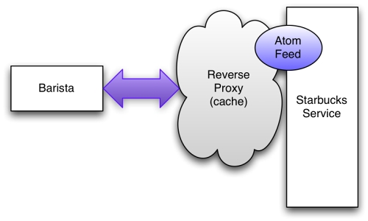
How to Get a Cup of Coffee
Get a list of orders
Response:
<entry>
<published>2014-05-16T08:18:43Z</title>
<updated>2014-05-16T08:20:32Z</update>
<link rel=“alternate” type=“application.xml”
uri=“http://starbucks.example.com/order/1234”/>
<id>http://starbucks.example.com/order/1234</id>
<content type=“text+xml”>
<order xmlns=“http://starbucks.example.com/”>
<drink>latte</drink>
<additions>shot</additions>
<cost>4.00</cost>
</order>
<link rel=“edit”
type=“applicatioin/atom+xml”
href=“http://starbucks.example.com/order/1234”/>
. . .
</content>
</entry>

Slide 52
How to Get a Cup of Coffee
Get a list of orders
Request
PUT /order/1234 HTTP 1.1 Host: starbucks.example.com Content-Type: application/atom+xml Content-Length: ... <entry> . . . <content type=“text+xml”> <order xmlns=“http://starbucks.example.com/”> <drink>latte</drink> <additions>shot</additions> <cost>4.00</cost> <status>preparing</status> </order> . . . </content> </entry>

Slide 53
How to Get a Cup of Coffee
Check payment of orders
Request | Response
GET /payment/order/1234 HTTP 1.1 Host: starbucks.example.org | 401 Unauthorized WWW-Authenticate: Digest realm="starbucks.example.com", qop="auth", nonce="ab656...", opaque="b6a9..."
Request | Response
GET /payment/order/1234 HTTP 1.1 Host: starbucks.example.org Authorization: Digest username="barista joe" realm="starbucks.example.com" nonce="..." uri="payment/order/1234" qop=auth nc=00000001 c nonce="..." reponse="..." opaque="..." | 200 OK Content-Type: application/xml Content-Length: ... 123456789 07/07 John Citizen 4.00

Slide 54
How to Get a Cup of Coffee
Delete a order
Request | Response
DELETE /order/1234 HTTP 1.1 Host: starbucks.example.org | 200 OK

Slide 55
Building a RESTful Web Service
GreetingController.java
@RestController public class GreetingController { private static final String template = "Hello, %s!"; private final AtomicLong counter = new AtomicLong(); @GetMapping("/greeting") public Greeting greeting(@RequestParam(value = "name", defaultValue = "World") String name) { return new Greeting(counter.incrementAndGet(), String.format(template, name)); } @PostMapping("/greeting") public Greeting greetingpost(@RequestParam(value = "name", defaultValue = "Spring") String name) { return new Greeting(counter.incrementAndGet(), String.format(template, name)); } }

Slide 56
Building a RESTful Web Service
Greeting.java
public record Greeting(long id, String content) { }

Slide 57
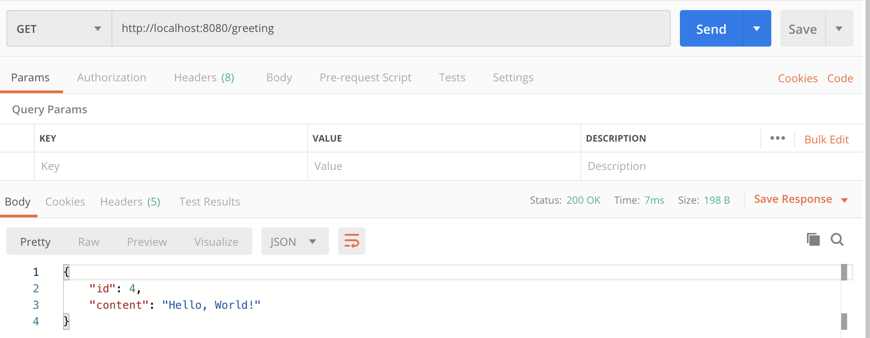
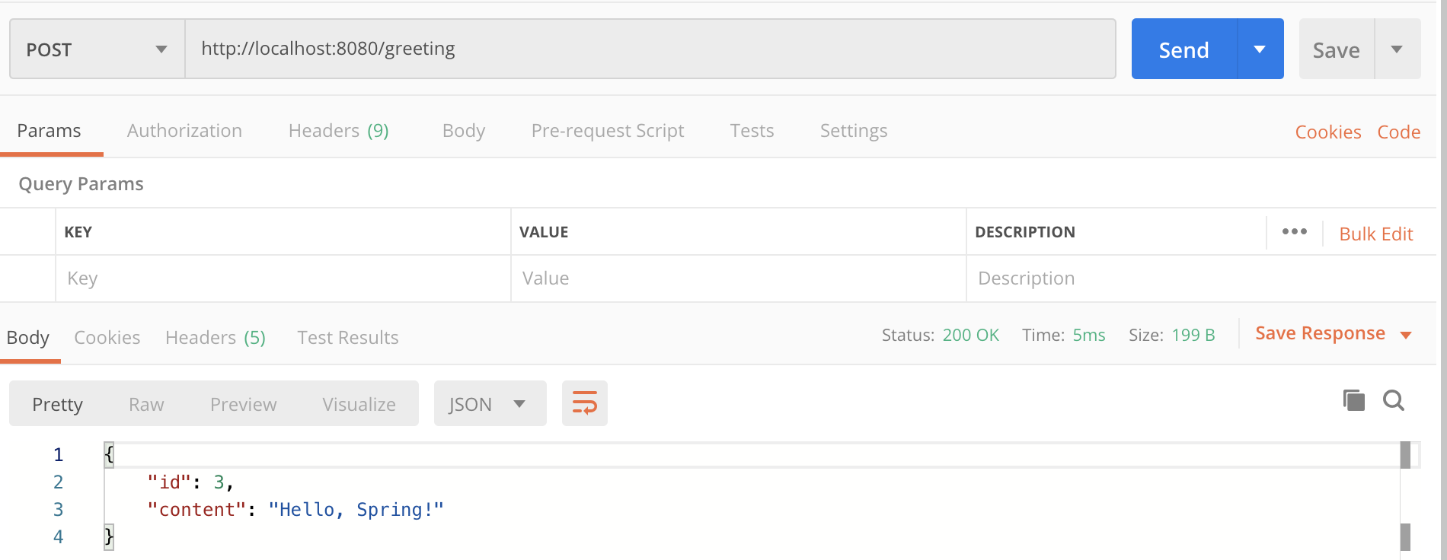
Consuming a RESTful Web Service
Test the RESTful Web Service

Slide 58
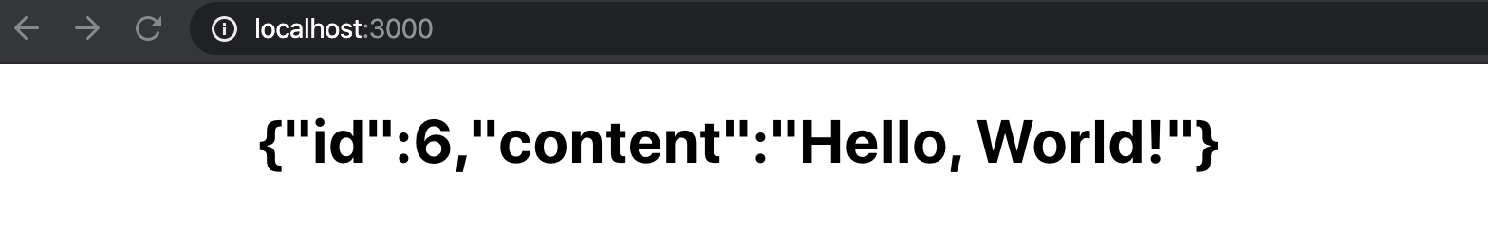
Consuming a RESTful Web Service
App.js
import React from 'react'; import logo from './logo.svg'; import './App.css'; function App() { fetch('http://localhost:8080/greeting') .then(response => response.json()) .then(data => { document.getElementById("anh").innerText = JSON.stringify(data) console.log('parsed json', data) }).catch(function (ex) { console.log('parsing failed', ex) }) return ( <div className="App"> <h1 id="anh"></h1> </div> ); } export default App;

Slide 59
Consuming a RESTful Web Service
CorsConfig.java
Cross origins
@Configuration public class CorsConfig implements WebMvcConfigurer { @Override public void addCorsMappings(CorsRegistry registry) { registry.addMapping("/**") .allowedOriginPatterns("*") .allowedMethods("*") .allowedHeaders("*") .exposedHeaders(HttpHeaders.SET_COOKIE) .allowCredentials(true).maxAge(1800); } }

Slide 60
Trade-off of WS
Advantages:
Across platforms
XML-based, independent of vendors
Self-described
WSDL: operations, parameters, types and return values
Modulization
Encapsulate components
Across Firewall
HTTP
Disadvantages:
Lower productivity
Not suitable for stand-alone applications
Lower performance
Parse and assembly
Security
Depend on other mechanism, such as HTTP+SSL

Slide 61
When
When we should use WS:
Support communication across firewall
Support application integration
Support B2B integration
Encourage reusing software
When we should NOT use WS:
Stand-alone applications
Such as MS Office
Homogeneous applications in LAN
Such as communication between COM+s or EJBs

Slide 62
References
Producing a SOAP web service
https://spring.io/guides/gs/producing-web-service/
Consuming a SOAP web service
https://spring.io/guides/gs/consuming-web-service/
Building a RESTful Web Service
https://spring.io/guides/gs/rest-service/
Notes:
org.reins.wssample.wsdl

Slide 63

Thank You!

